Slide 1


Jonathan McHarg
Consulting Limited
Jonathan McHarg

Slide 2







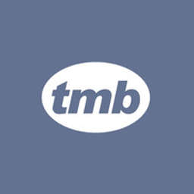
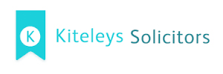



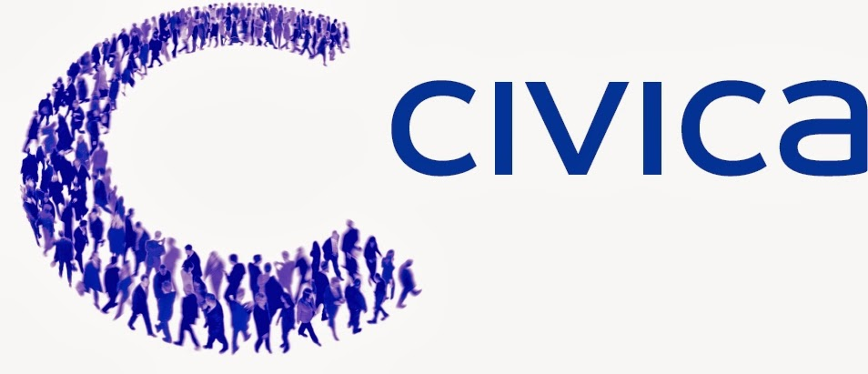







Where have I worked?

Slide 3
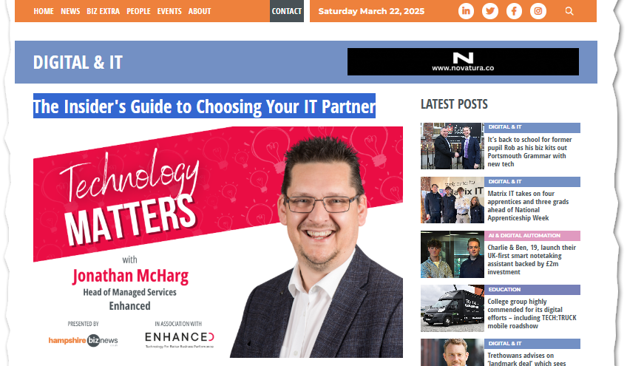


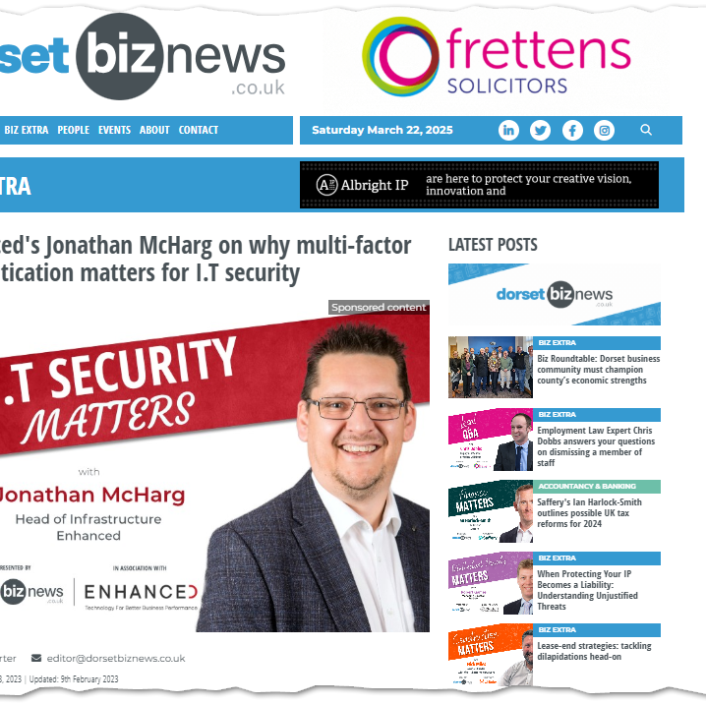


Award Winning and Published!

Slide 4





Outside of work

Slide 5


Slide 6

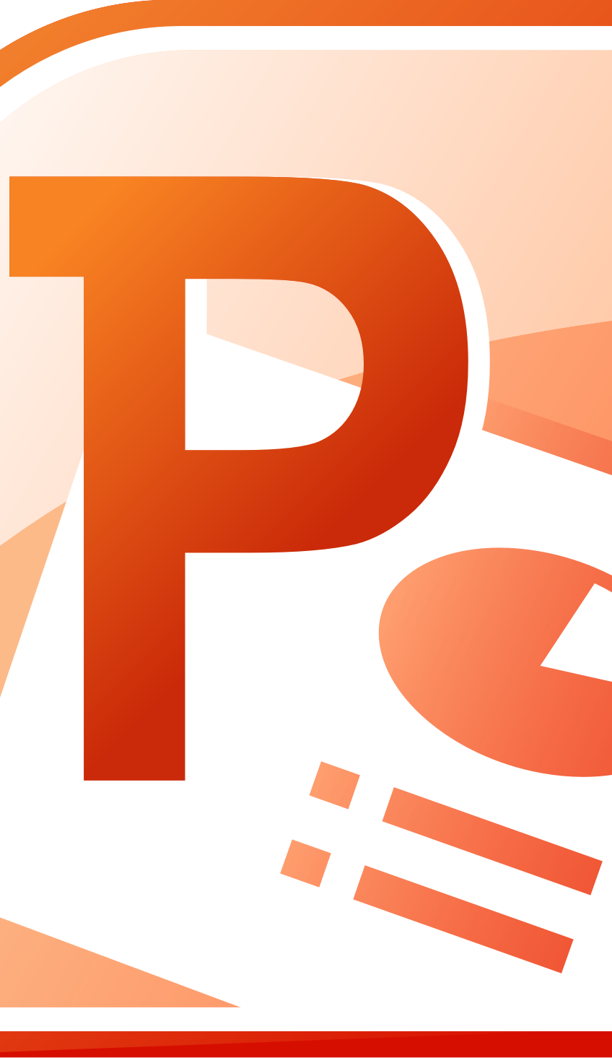

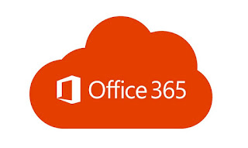

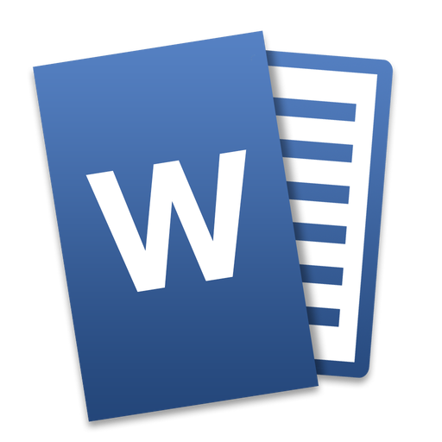
There’s more to Office 365!

Slide 7
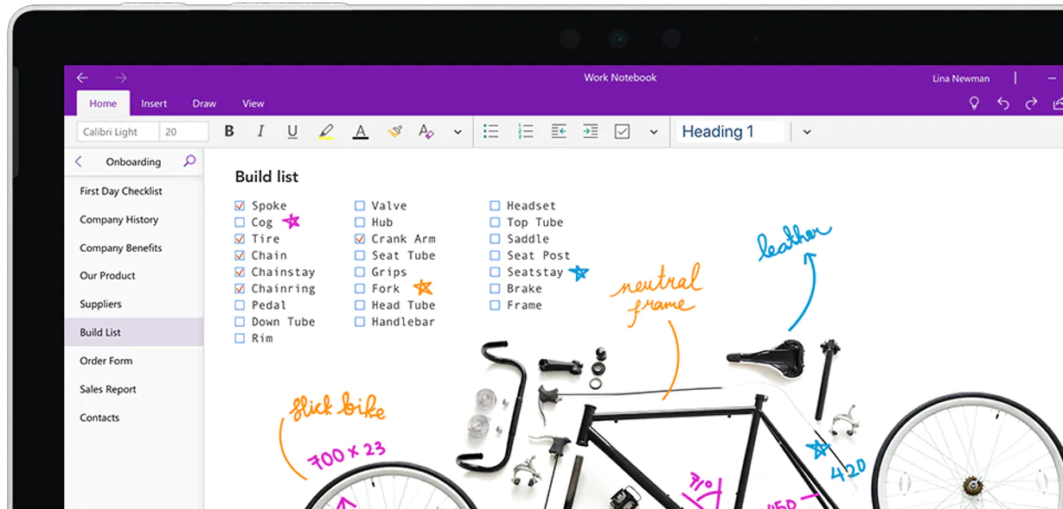
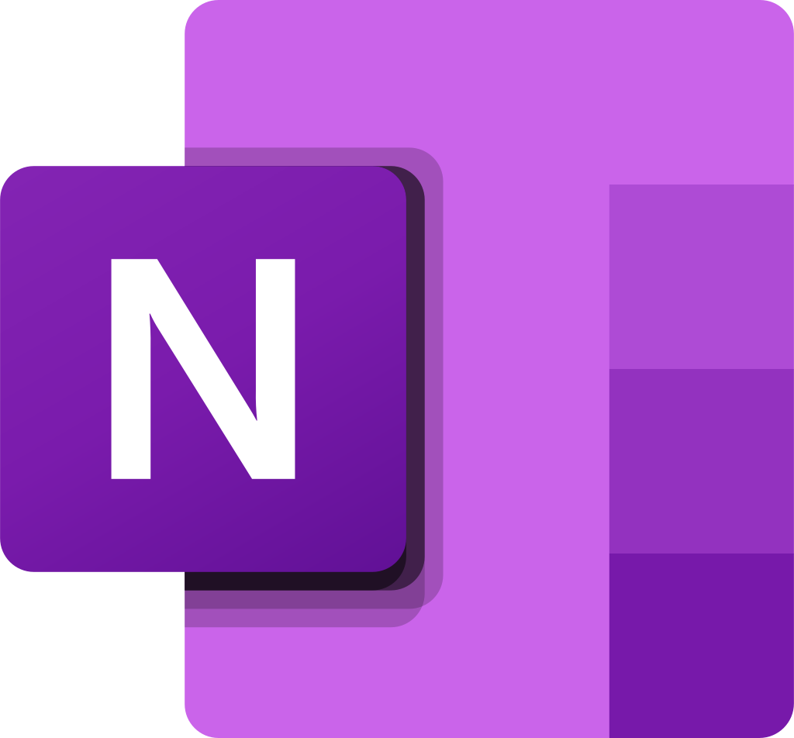
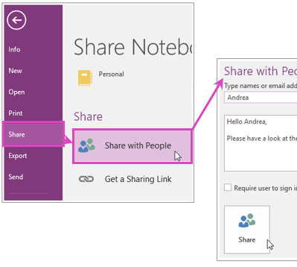
Microsoft OneNote
Why it's underused: Many see it as just a digital notebook and overlook its collaborative and organizational power.
Efficiency Gains:
Centralised Knowledge Base: Create shared notebooks for teams to document processes, meeting notes, and project plans.
Real-Time Collaboration: Multiple users can edit and contribute simultaneously, reducing email clutter.
Integration: Syncs with Outlook and Teams for seamless task and meeting management.

Slide 8

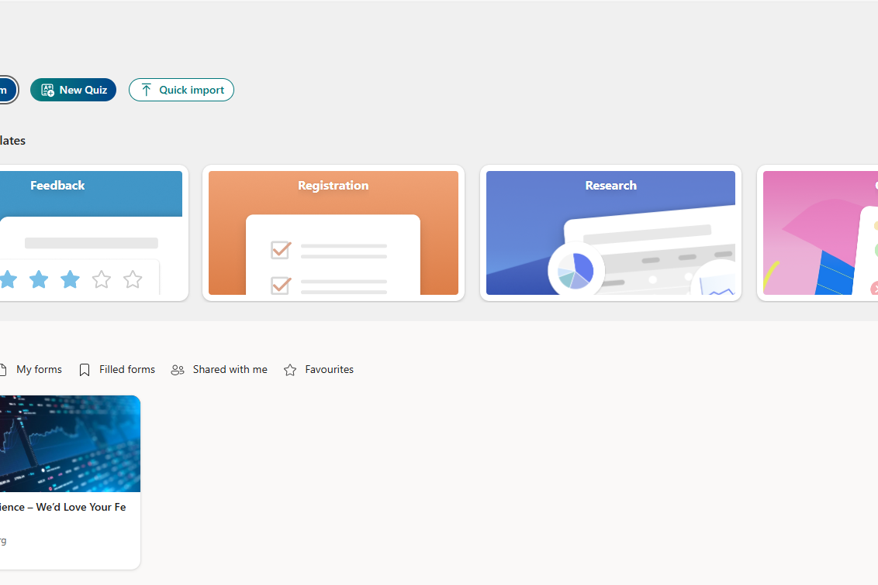

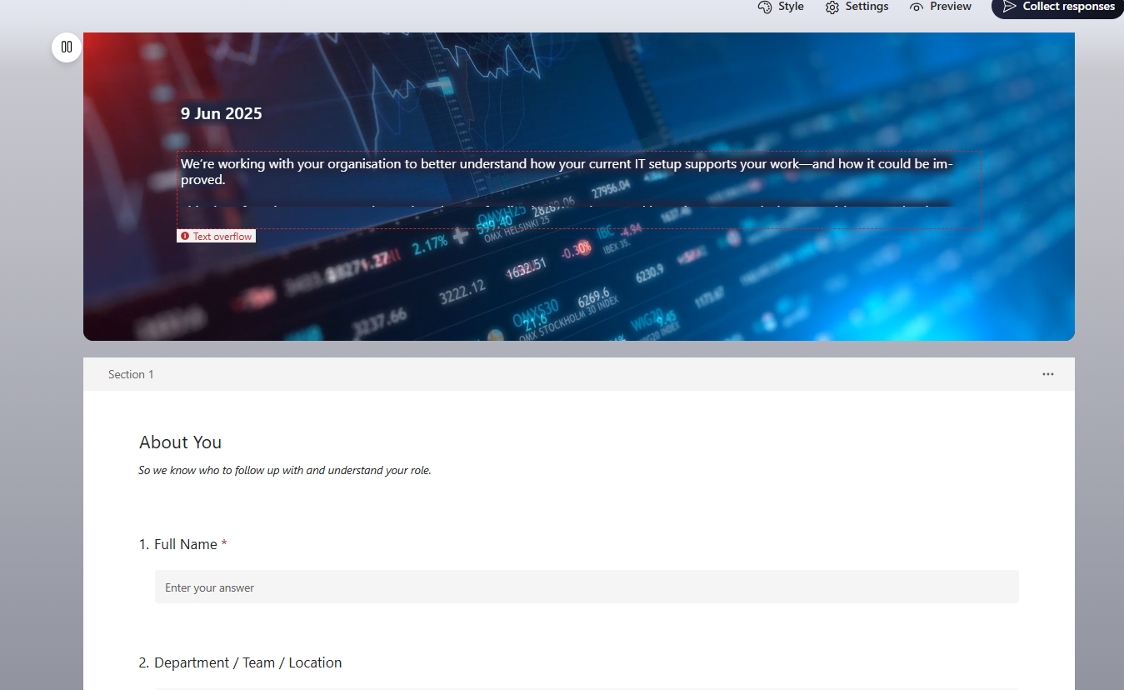
Microsoft Forms
Why it's underused: Often overshadowed by more complex survey tools like SurveyMonkey or Google Forms.
Efficiency Gains:
Quick Feedback Collection: Easily gather customer or employee feedback, conduct polls, or run internal assessments.
Automation: Responses can trigger workflows in Power Automate, such as sending alerts or updating SharePoint lists.
Data Analysis: Automatically integrates with Excel for real-time data analysis and visualization.

Slide 9


Microsoft Planner
Why it's underused: Many teams default to tools like Trello or Asana without realising Planner is already included in Microsoft 365.
Efficiency Gains:
Task Management: Visual task boards help teams track progress, assign responsibilities, and meet deadlines.
Integration with Teams: Tasks can be managed directly within Microsoft Teams, keeping everything in one place.
Transparency: Everyone can see who’s doing what, reducing miscommunication and improving accountability.

Slide 10

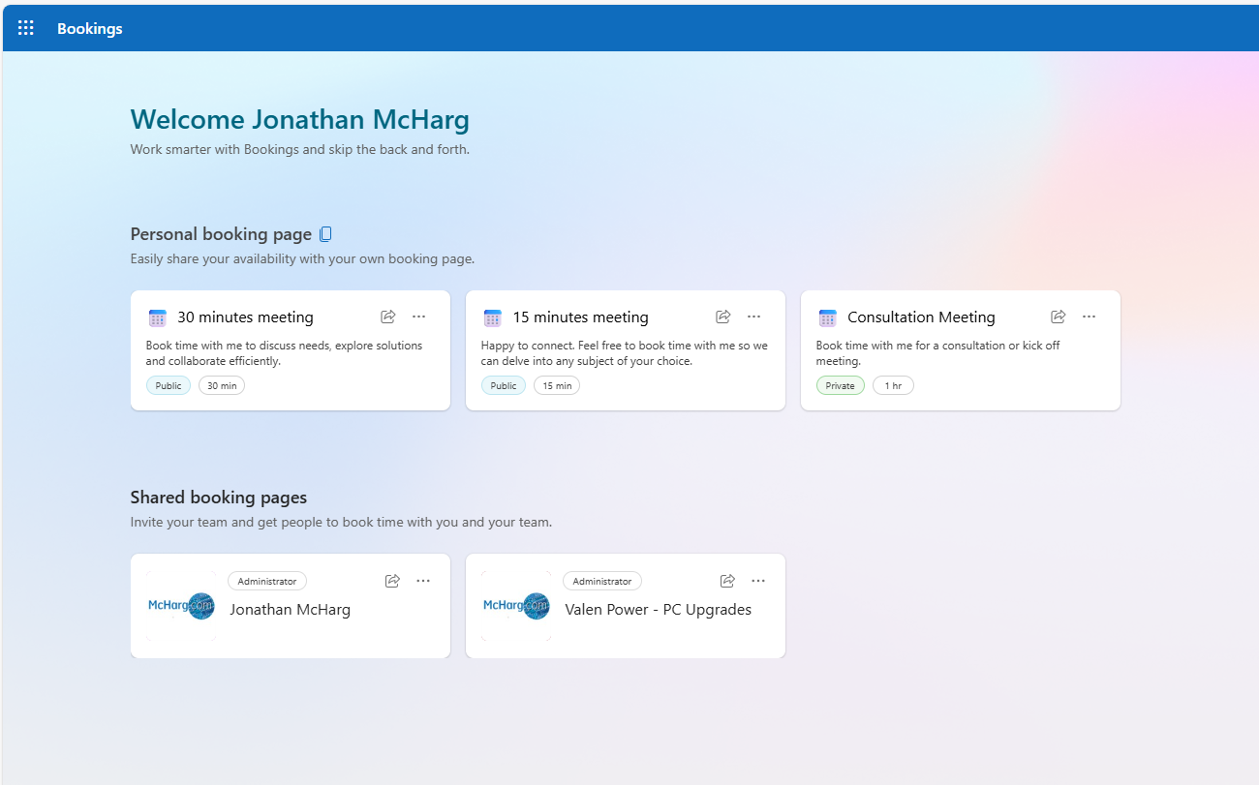
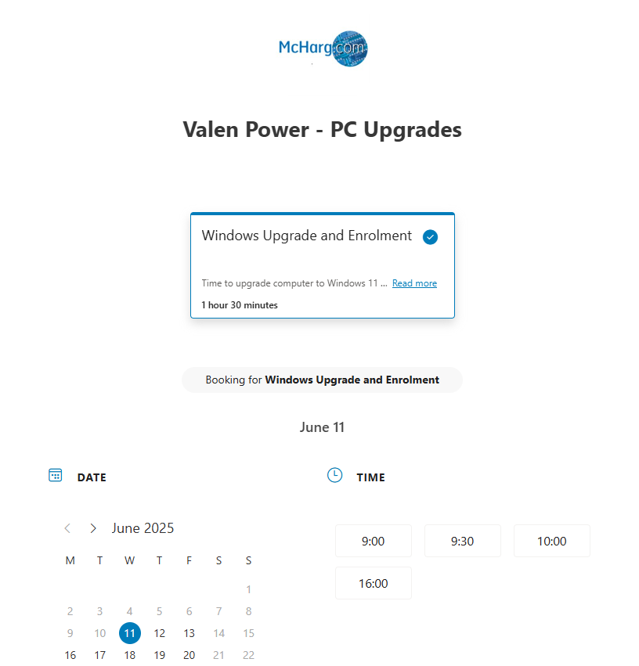
Microsoft Bookings
Why it's underused:
Often overlooked because businesses default to external scheduling tools like Calendly or Acuity.
Some assume it’s only for service-based industries like salons or clinics, not realizing its broader potential.
Limited awareness of its integration with Outlook and Teams.
Efficiency Gains:
Streamlined Scheduling: Clients or colleagues can book time directly based on real-time availability, reducing back-and-forth emails.
Automated Reminders: Sends confirmations and reminders automatically, reducing no-shows and improving time management.
Customizable Services: Tailor appointment types, durations, and staff assignments to fit business needs.
Data Insights: Track appointment trends and customer engagement to improve service delivery.

Slide 11
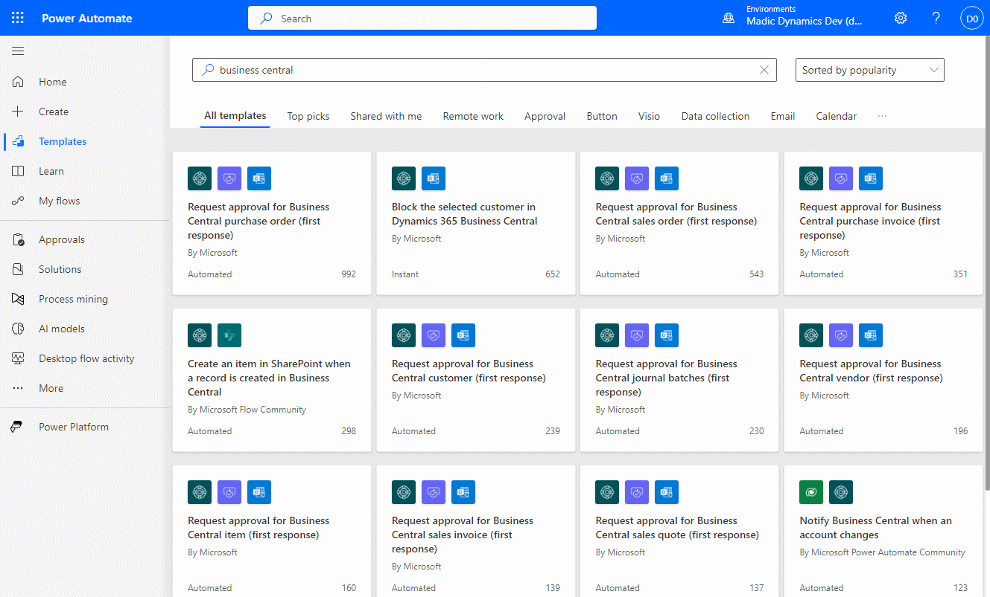

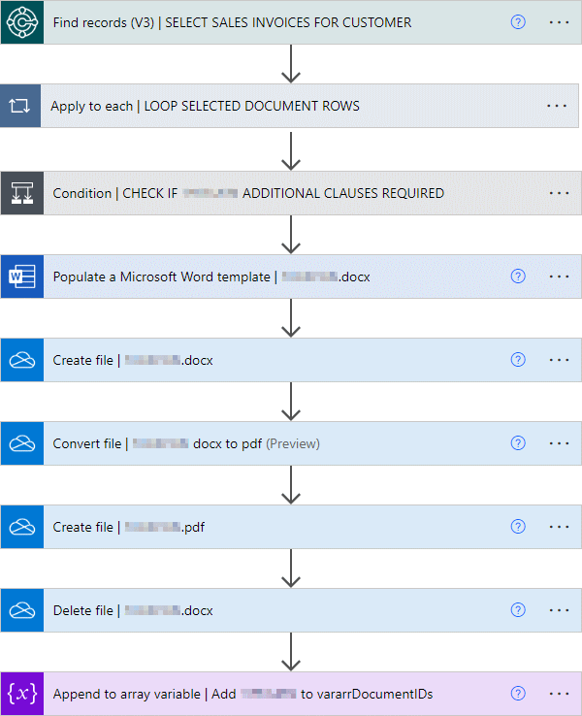
Power Automate
Why it's underused:
Many users are unaware of its capabilities or assume automation requires coding skills.
It’s often overshadowed by more visible apps like Excel or Outlook, even though it can enhance both.
The interface can seem intimidating at first glance, especially for non-technical users.
Efficiency Gains:
Workflow Automation: Automate repetitive tasks like approvals, notifications, and data entry across apps (e.g., Outlook, SharePoint, Teams).
Error Reduction: Minimizes manual input, reducing human error in processes like invoicing or data migration.
Time Savings: Frees up employee time by handling routine tasks, allowing focus on higher-value work.
Integration Power: Connects with hundreds of services (including third-party apps) to streamline cross-platform operations.
This Photo by Unknown Author is licensed under CC BY-SA-NC

Slide 12

Summary
Some or all these applications will already be available to you if you have an Office 365 subscription.
There are no additional costs to using them!
I’m here to help!

